Slide 1
Group 002 : Course-Hub
Mid Semester Review
Abhijeet Kharkar, Indranil Guha, Nabeel Ahmed Khan and Ali Asghar

Slide 2
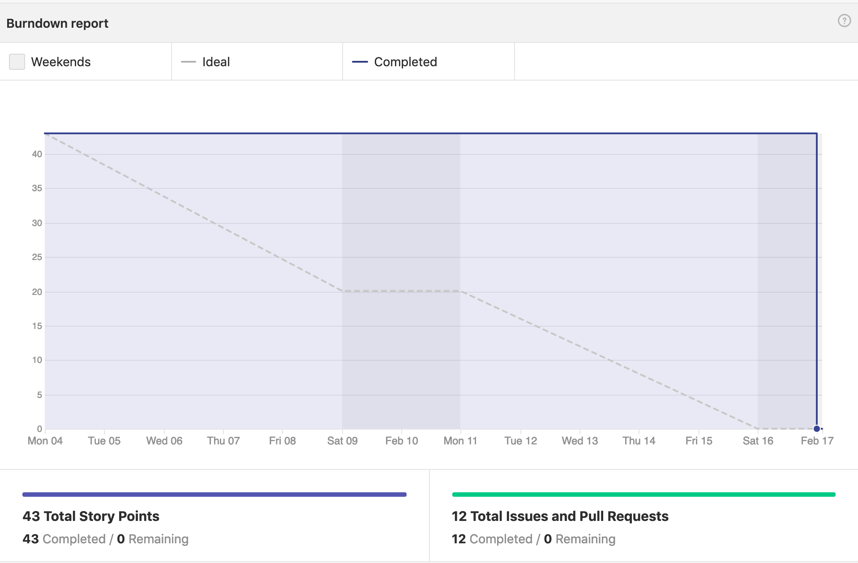
Key Milestones - Sprint 1
Setup ElasticSearch(ES) database
Loaded data into ES from multiple course API’s
Initial Frontend and Backend app for the project
Set up Semaphore CI
Testing Coverage : 90%

Slide 3
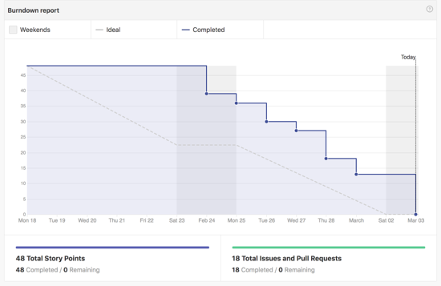
Milestones - Sprint 2
Implemented autosuggest during course search
Authentication using Firebase
Profile Management using ElasticSearch
App Setup using Webpack and Babel for dev env
Testing Coverage : 75%

Slide 4
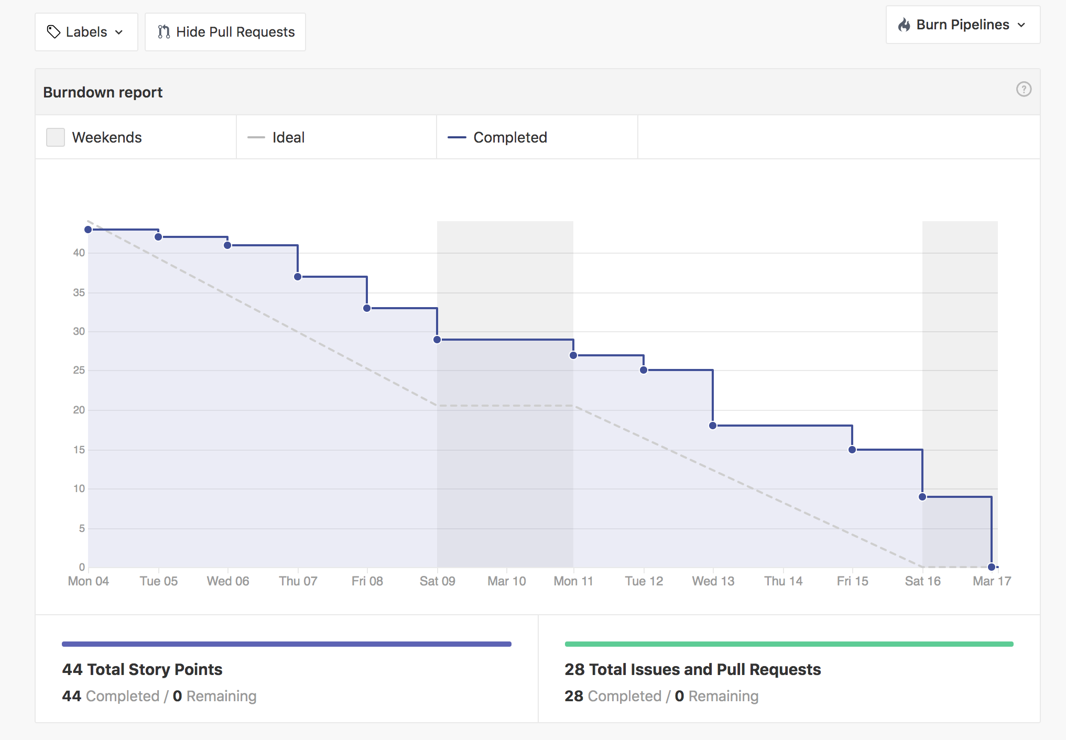
Milestones - Sprint 3
Paginated Backend API’s for course search
FrontEnd app layout.
Set up Docker environment
Set up webpack and babel for Production environment
Testing Coverage : 89%

Slide 5
Future Sprints
Course Deals [Sprint 4]
User Reviews [Sprint 4]
Course Comparison [Sprint 4]
Microdegree functionality [Sprint 5]
Functional Testing [Sprint 5]
Product Tuning [Sprint 6 - Final Sprint]

Slide 6
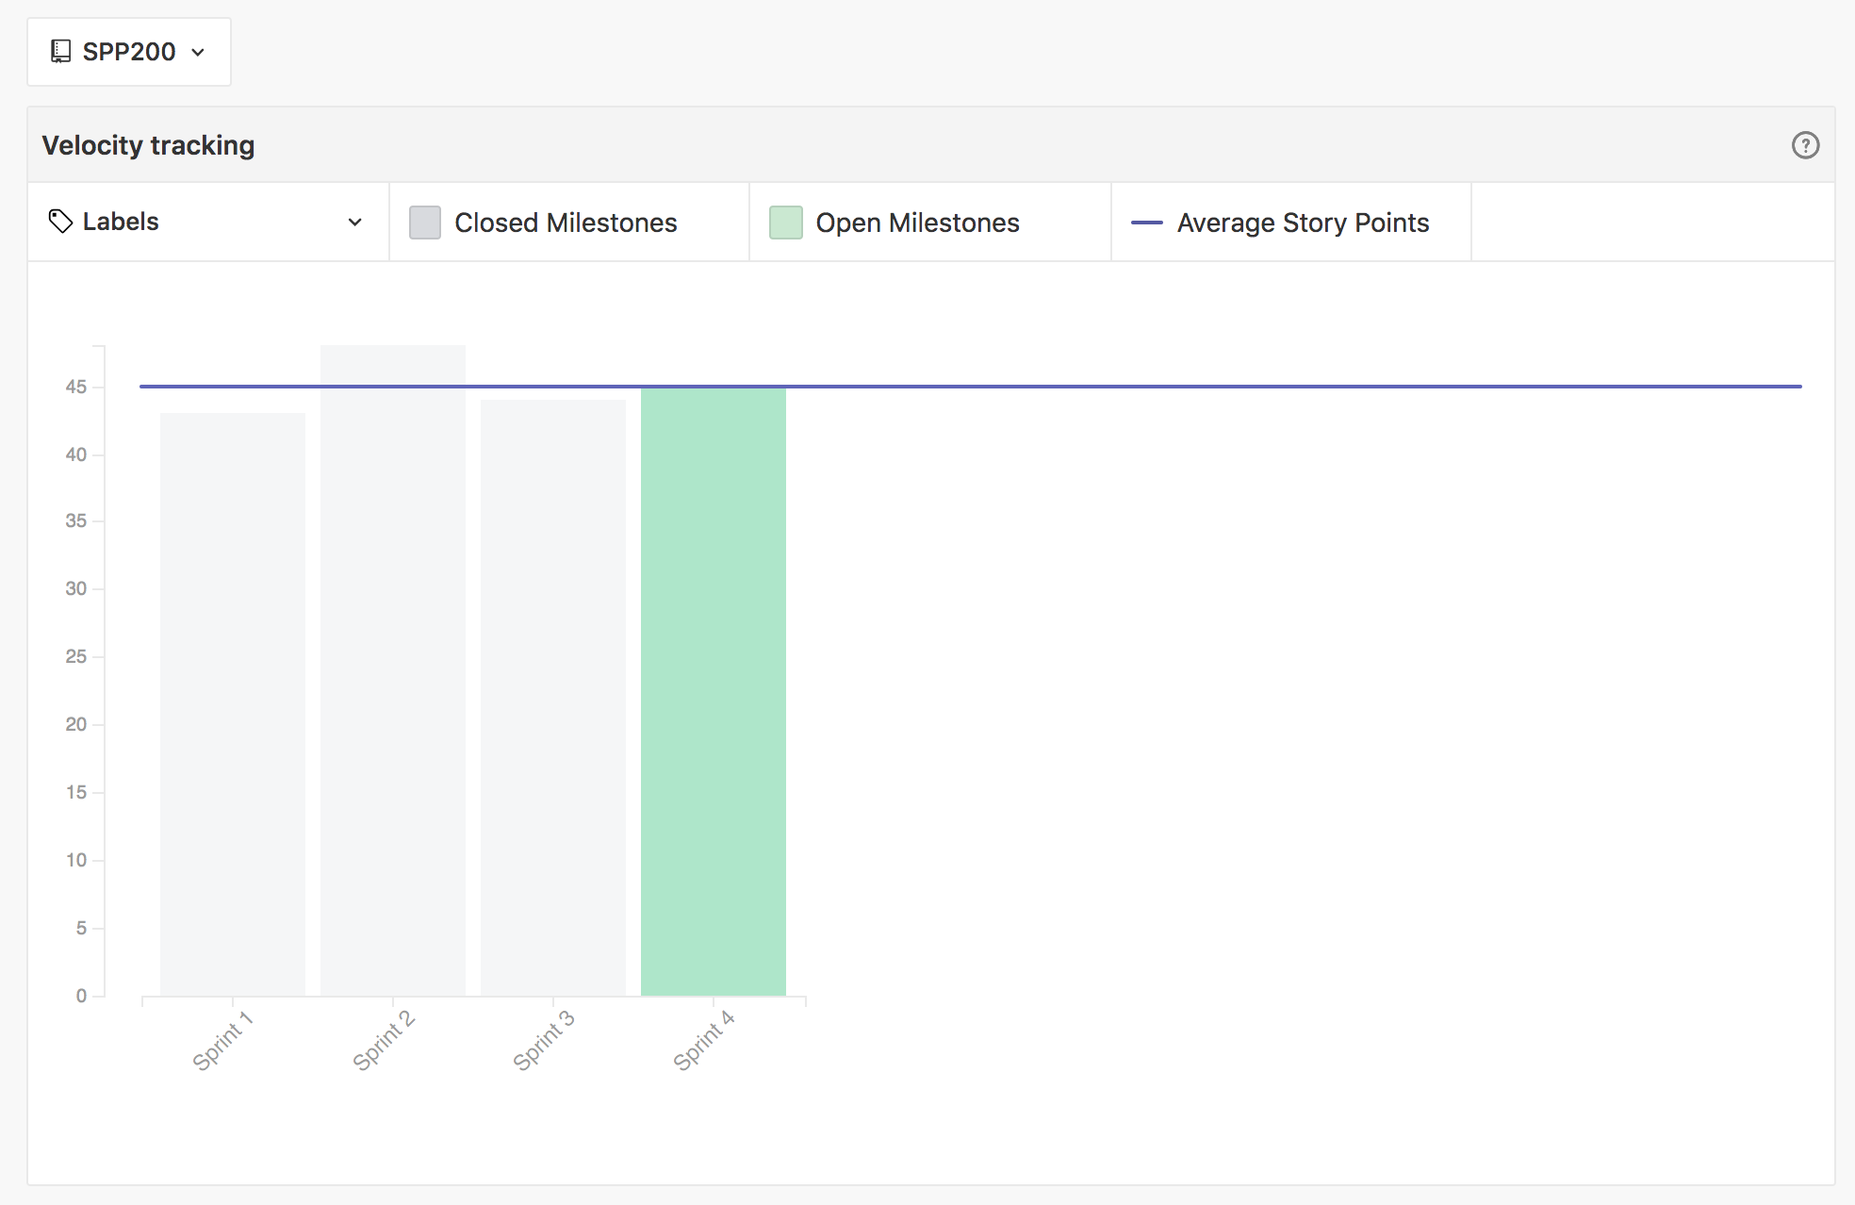
Velocity
Consistent Velocity across all the sprints ~ 45 points

Slide 7
Challenges Faced
Data collection from multiple API sources and setting up ES database
Setting up continuous integration environment
Breaking down large user stories into smaller issues
Managing burndown rates
Maintaining consistent theme across the project.

Slide 8
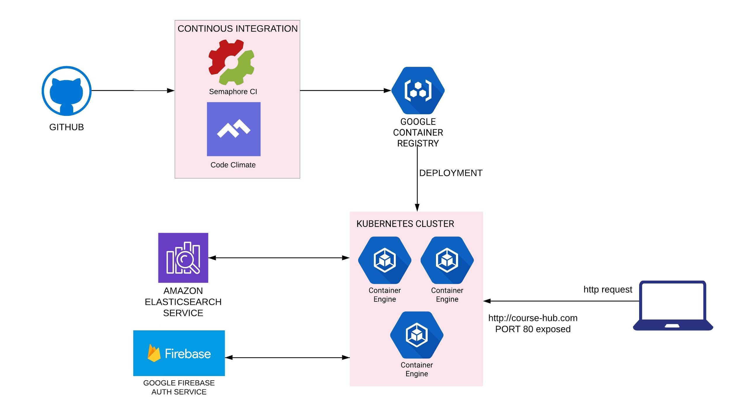
Product Architecture

Slide 9
Demo

Slide 10
Questions?

